Slide 1

Project Title: Text Summarization
Created by Leila Megdiche,

Slide 2
The content :
WHAT IS THE PROJECT
SOME CODES
The Text summarazation
Parts of my code
INTRODUCTION
STEPS NEED FOR IT
RESULT
What is NLP ?
How do we code the project
The final result with interface

Slide 3
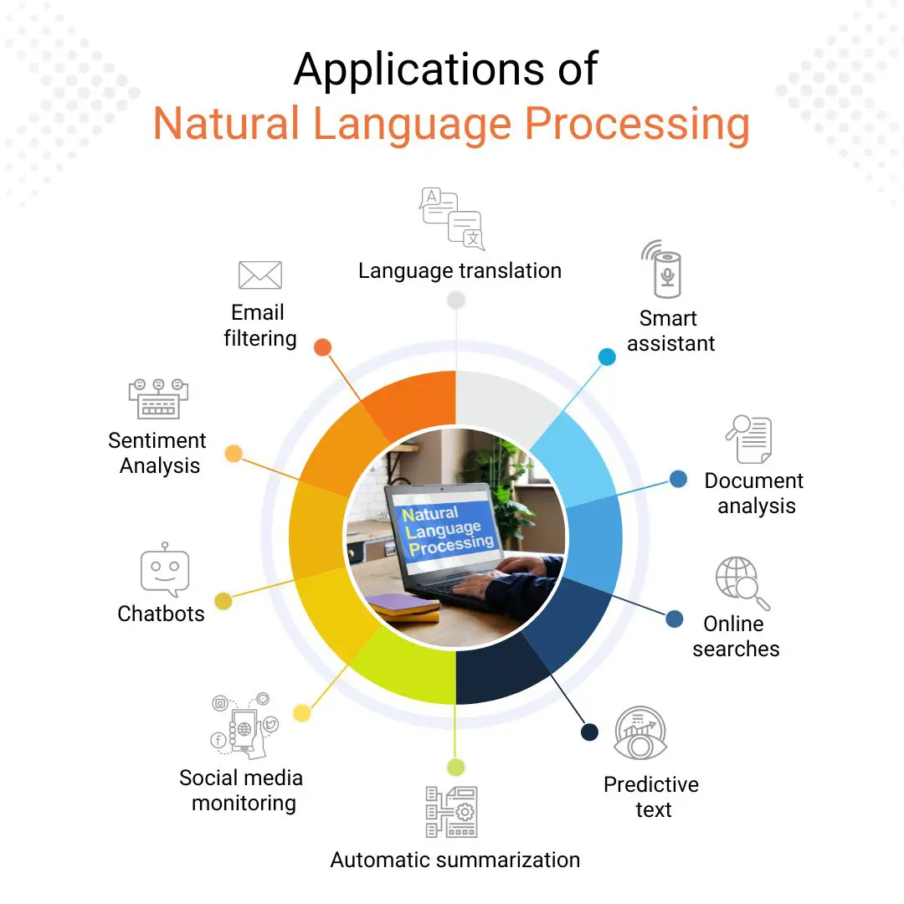
General introduction
Natural language processing (NLP) refers to the branch of computer science” and more specifically, the branch of artificial intelligence or AI” concerned with giving computers the ability to understand text and spoken words in much the same way human beings can.
NLP drives computer programs that translate text from one language to another, respond to spoken commands, and summarize large volumes of text rapidly, even in real-time

Slide 4
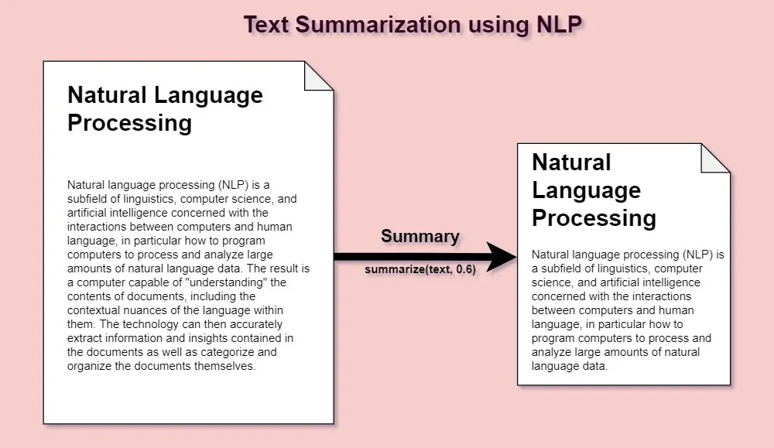
Introduction to the project
Automatic text summarization essentially condenses a long document into a shorter format while preserving its information content and overall meaning. It is a potential solution to the information overload. Several automatic summarizers exist in the literature capable of producing high-quality summaries, but they do not focus on preserving the underlying meaning and semantics of the text.

Slide 5
the benefits of automated text summarization
Automatic text summarization is useful in many ways:
Automatic summaries are less biased as compared to human-generated summaries.
summaries are pivotal to the question-answering systems.
indexing is effective if automatic summarizers are used.
reading a summary instead of document reduces reading time.
summaries make selection of articles easier during researching.
commercial abstracting services employ automatic summarizers to effectively increase their throughput by producing large number of summaries in a shorter time.

Slide 6
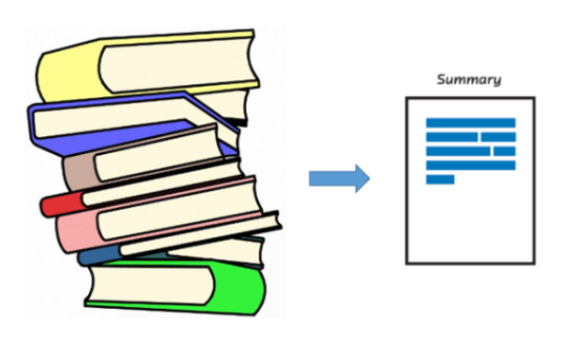
Project Objective
The objective of automatic text summarization (automatic summarization/text summarization) is the reduction of a given text to a smaller number of sentences without leaving out the main ideas of the original text. The architecture of a summarization system consists of interpretation, transformation, and generation.

Slide 7





Here are the steps involved in the text summarization project
Step 01
Data Collection: Collect a dataset of text documents that you want to summarize. like news articles. Preprocessing: Clean the text data to remove any irrelevant information,
Word Embeddings: pre-trained word embeddings, such as GloVe, semantic relationships between words, toknow the meaning of the text.
Step 03
Sentence Tokenization:Tokenize the text into sentences using a sentence tokenizer.
Sentence Similarity Calculation:measures the similarity in meaning
Step 02
Step 04
Step 05
Generate Summary:Concatenate the selected sentences to form the final summary,
User Interface:Develop a user interface that allows users to input text and view the generated summary.
Sentence Ranking:Rank the sentences based on their similarity scores.
Select Top Sentences:top-ranked sentences based on a predefined threshold or a fixed number of sentences.

Slide 8
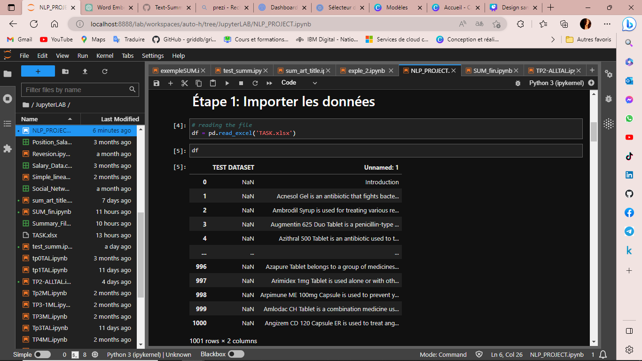
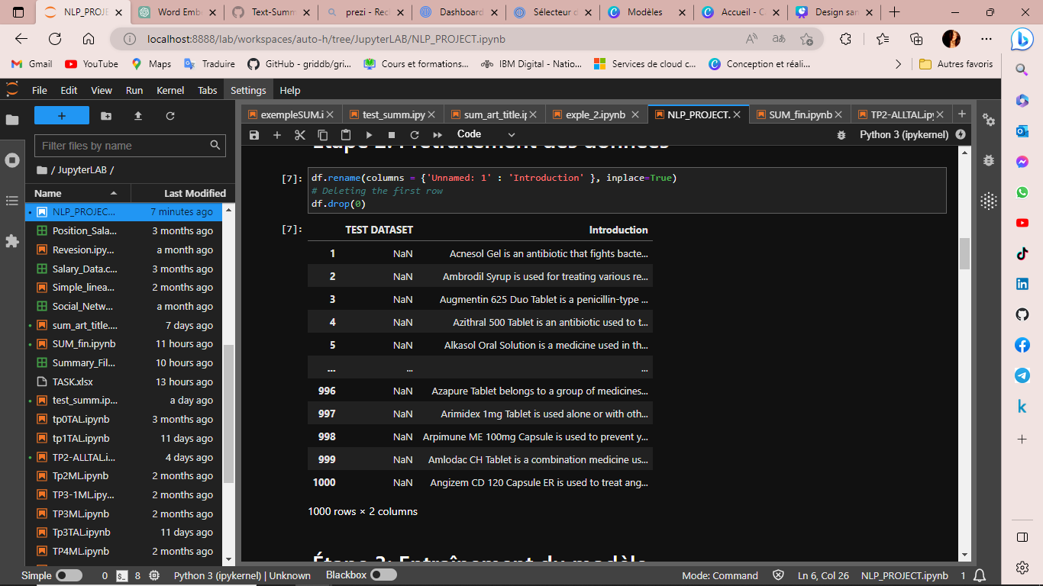
Step n°1: Data Collection and Preprocessing
Data Collection
Clean and preprocess the text data

Slide 9
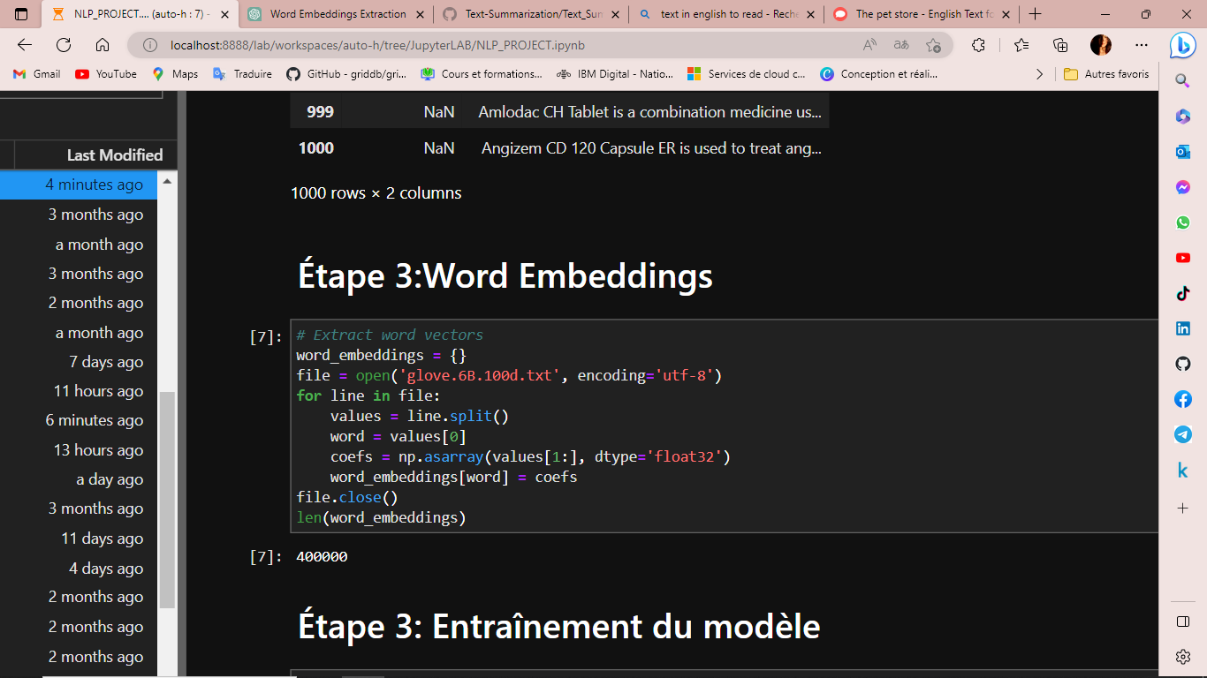
Step n°2: Word Embeddings
Utilize pre-trained word embeddings, such as GloVe or Word2Vec, to represent words as dense vectors. These word embeddings capture semantic relationships between words, which is crucial for understanding the meaning of the text.

Slide 10
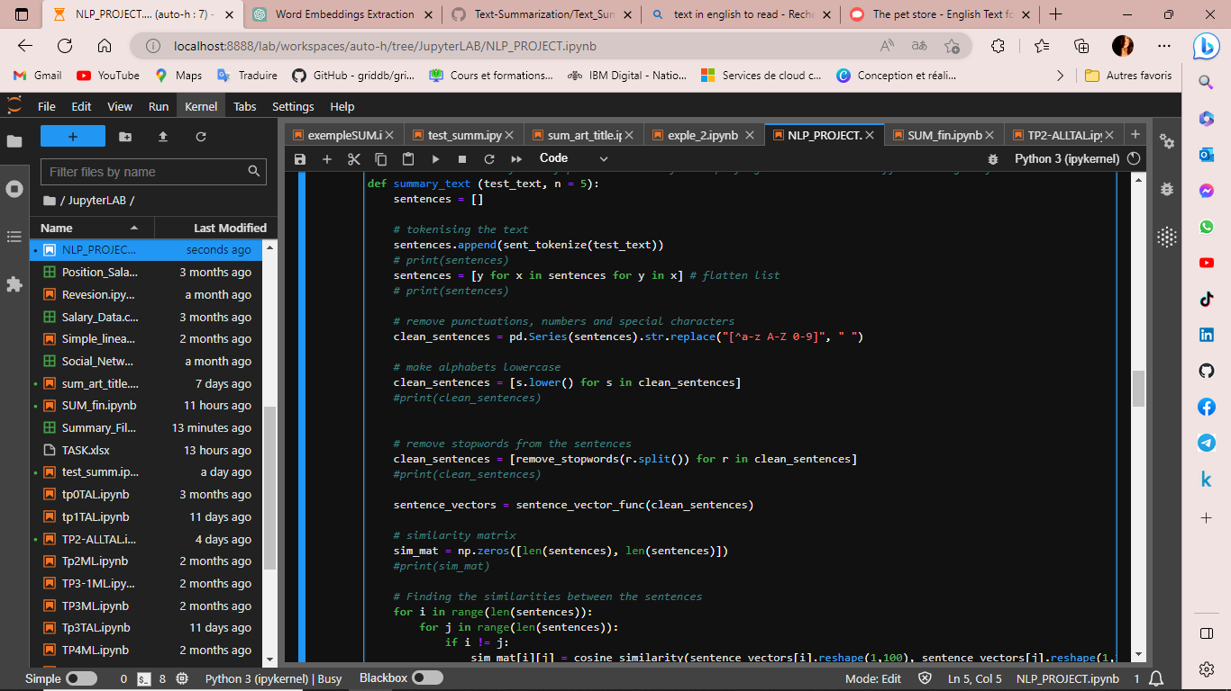
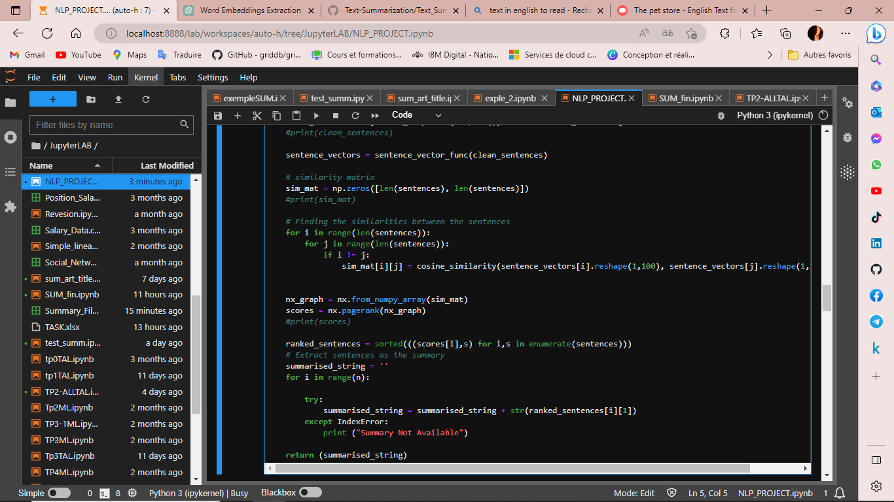
Step n°3: Sentence Similarity Calculation
Sentence Tokenization
Sentence Similarity Calculation

Slide 11
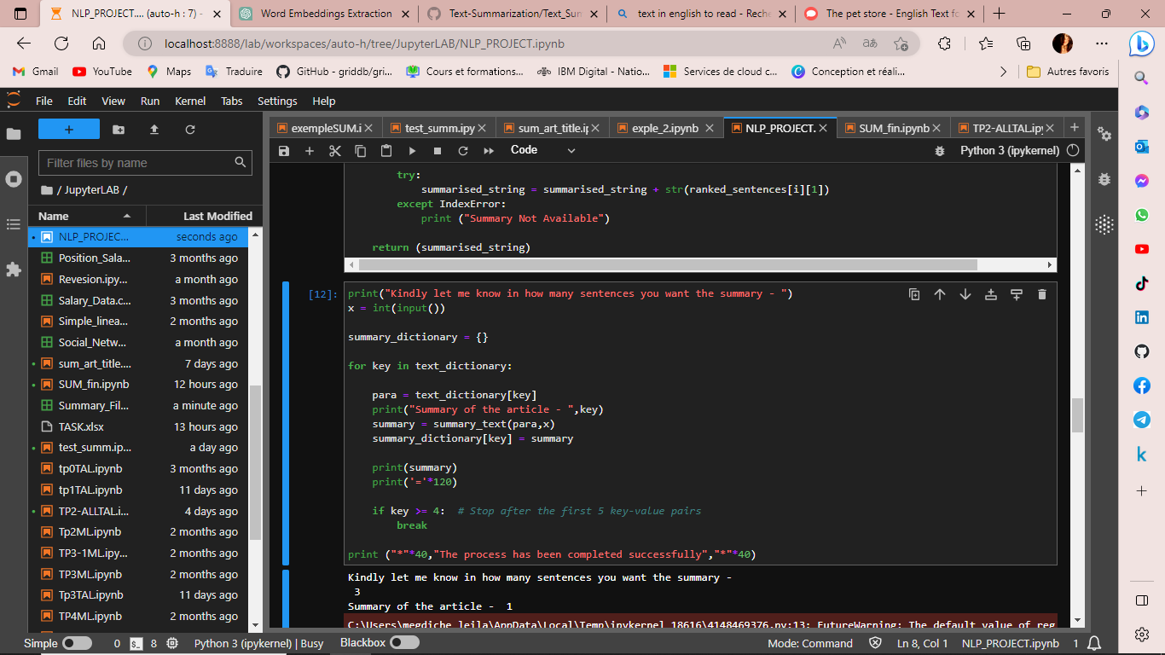
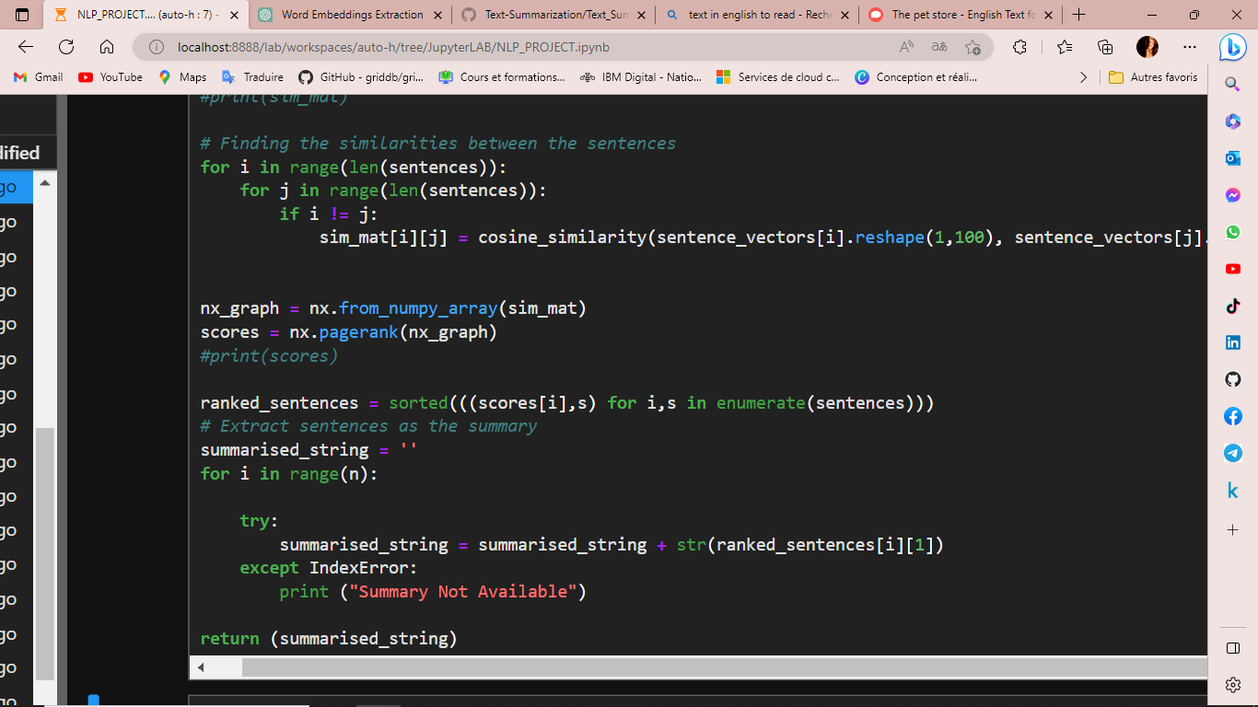
Step n°4: Text Summarization Algorithm
Sentence Ranking
Select Top Sentences

Slide 12
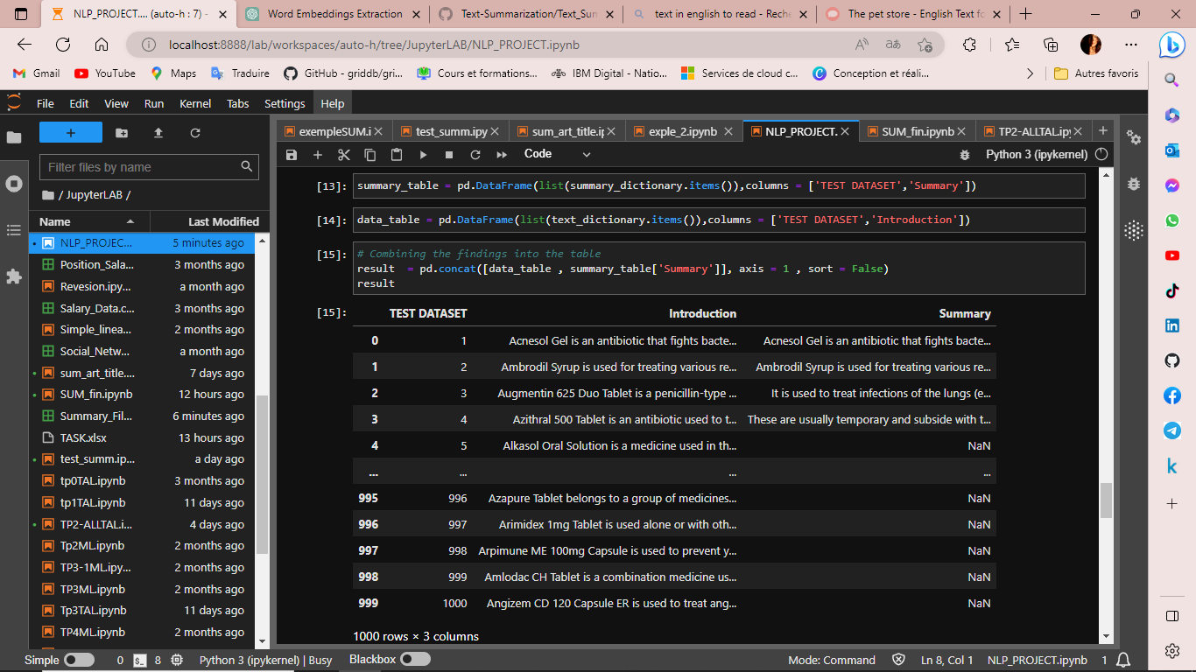
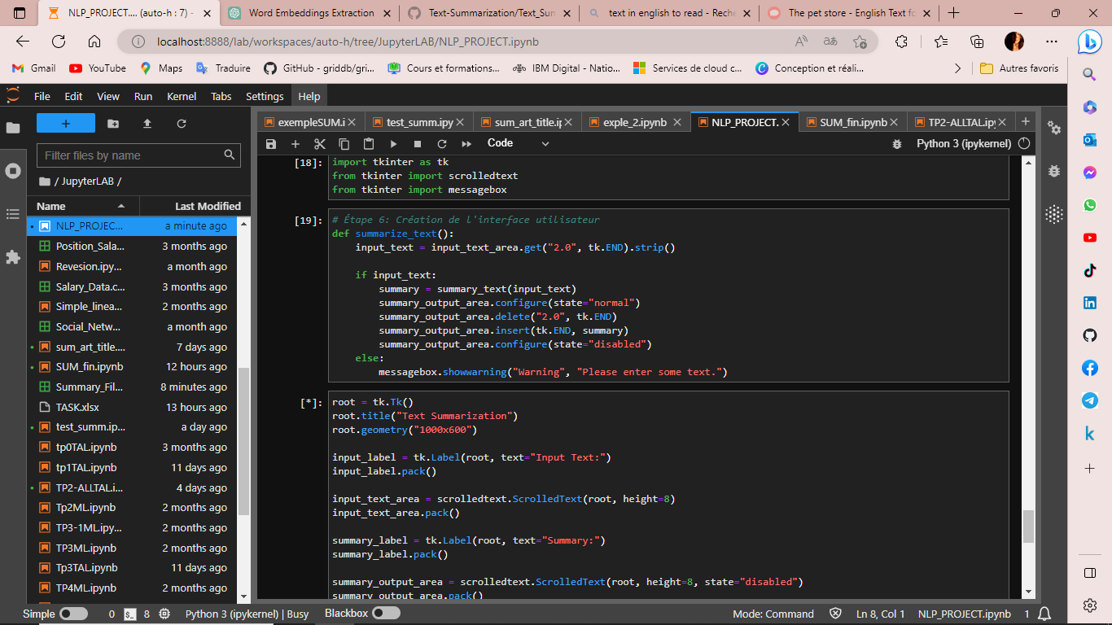
Step n°5: the result
Generate Summary
User Interface

Slide 13
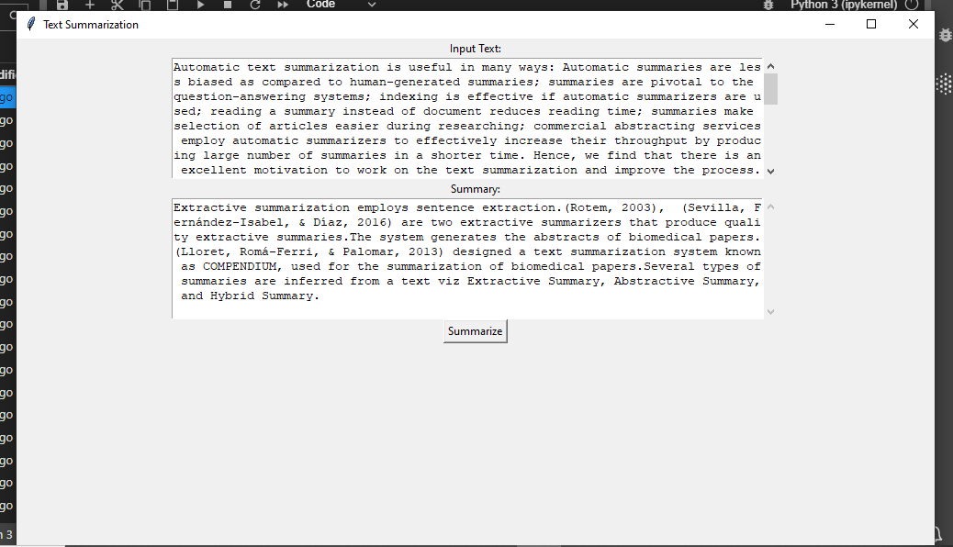
A simple User interface

Slide 14
Conclusion
Text Summarization Algorithm
NLP
AI
Machine learning

Slide 15

I'm grateful for your attention.
megdicheleila00@gmail.com

